Slide 1




Dashboards for DevOps:
How to Set Up The Right Reports to Help Teams Monitor the Metrics that Matter
PRESENTED BY
www.stratussolutions.com
Brian Price
VP, Commercial Services
Dave Page
Sr. DevOps Engineer

Slide 2
Topics
Overview of Stratus Solutions
The Software Efficiency Challenge
The Value of DevOps Dashboards
DevOps Dashboard Examples and Demo
Customer Success Stories

Slide 3





Stratus Solutions Company Snapshot
Our Core Competencies
Stratus Solutions is a technology partner that enables purpose-led organizations to achieve more
Our areas of expertise include DevOps, cloud infrastructure, and cyber security
Founded in
2008
Headquartered
in Fulton, MD
Developer Operations
Complete DevOps engineering services that enable teams to accelerate their software delivery and achieve efficiencies.
Cloud Infrastructure
Innovative solutions to help major companies and Government agencies to change the way they scale their IT infrastructure.
Cyber Security
Infused security techniques and best practices to ensure organizations meet regulatory standards and respond to threats.
Ranked #925 in
2016

Slide 4

























The Software Efficiency Challenge
GITLAB
Add Developers
Add Technologies

Slide 5

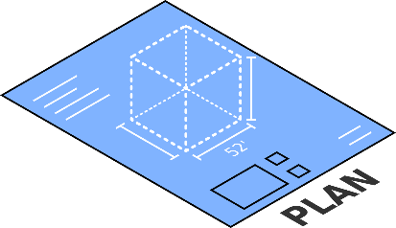
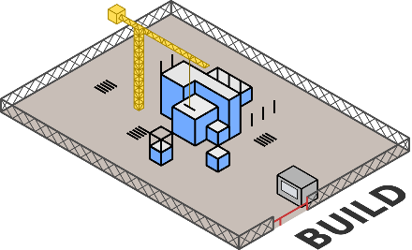

The Value of DevOps Dashboards
Issues Per Sprint
Commit Frequency
Reported Bugs
SLOC Changed
Velocity
Files Changed
[…]
Programming Languages
[…]
Passed Tests
Build Failures
Test Duration
Build Frequency
Failed Tests
Build Duration
[…]
Build Successes
[…]

Slide 6
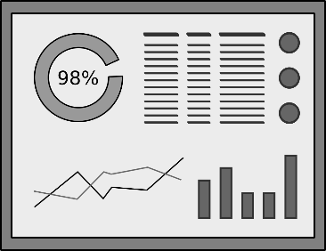
The Value of DevOps Dashboards
Issues Per Sprint
Commit Frequency
Reported Bugs
SLOC Changed
Velocity
Files Changed
[…]
Programming Languages
[…]
Passed Tests
Build Failures
Test Duration
Build Frequency
Failed Tests
Build Duration
[…]
Build Successes
[…]

Slide 7
The Value of DevOps Dashboards
DevOps dashboards help organizations quickly respond to bottlenecks, measure ROI from previous DevOps investments, and identify new investments to improve their release efficiency.

Slide 8







DevOps Dashboard Scenario:
Pied Piper
Product: Data Compression Software
Current Releases:
v 3.1 (minor)
new encryption algorithm, updated API
Platforms:
v 2.1 (minor)
new encryption algorithm, new features
Web App
Mobile App
v 2.0.1 (patch)
security vulnerability fix
Deployment Environments:
DEV
TEST
QA
PROD
PIED PIPER’S LOGOS, LIKELINESSES AND RELATED SERVICE MARKS ARE THE PROPERTY OF HOME BOX OFFICE, INC.

Slide 9
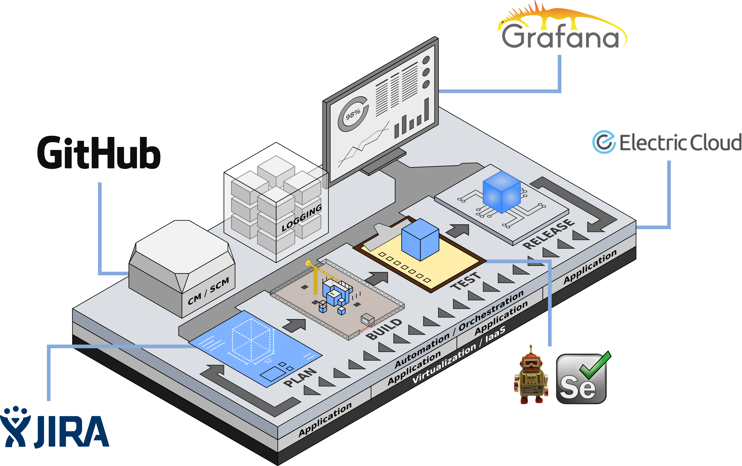
Pied Piper’s DevOps Environment
PIED PIPER’S LOGOS, LIKELINESSES AND RELATED SERVICE MARKS ARE THE PROPERTY OF HOME BOX OFFICE, INC.

Slide 10
DevOps Dashboard Demo

Slide 11


Highlighted Success Story #1
Company: Fortune 500 Aerospace and Defense Contractor
Product: Mission control system software for an unmanned aerial vehicle (UAV)
Environment: Virtualized On-Prem Leveraged by 10 Labs
Problem: Every Deployment Took ~12 days with upwards of 7 full time staff to perform
By integrating Electric Cloud’s Electric Flow continuous delivery platform to automate releases and integrate their existing DevOps workflow tools together we reduced deployment time to ~3 days with only 2 staff.
Efficiency Savings: ~600 Man Hours Per Month
Before
After

Slide 12
Highlighted Success Story #2
Company: Big Four Professional Services Company
Product: Healthcare Application
Environment: Hybrid Cloud (VMWare and MS Azure)
Problem: Developers were taking too long to fix issues. DevOps technology use was disjoint.
By integrating and configuring a more robust testing tool suite and implementing a dashboard across the DevOps environment to identify key bottlenecks, the product delivery lifecycle was streamlined, accelerating production releases.
Efficiency Gained: 15% Increase in team productivity in 3 months
15%
Productivity

Slide 13
Questions?

Slide 14
Thank You
For More Information
Visit
stratussolutions.com/devops
Email
opportunities@stratussolutions.com
Or Contact
Brian Price
VP of Commercial Services
bprice@stratussolutions.com
410-417-5317 x5080
Dave Page
Sr. DevOps Engineer
dpage@stratussolutions.com
410-417-5317 x5014

Slide 15
BACKUP SLIDES

Slide 16
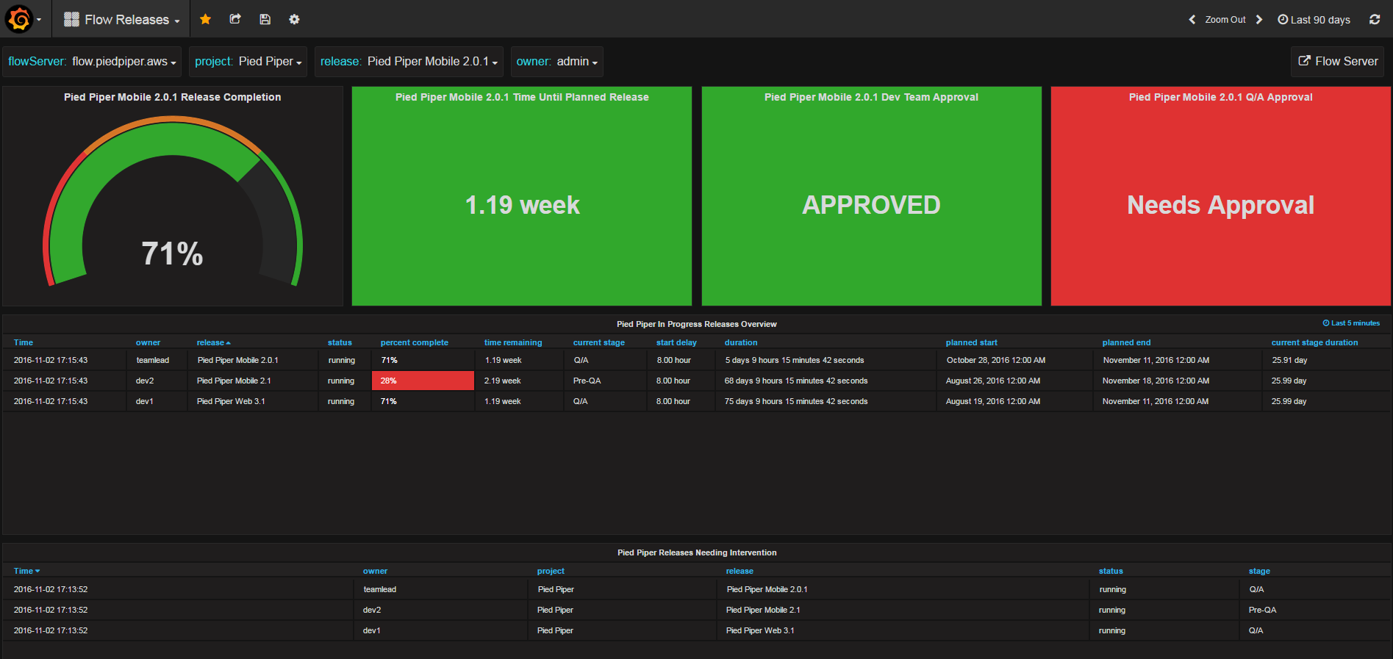

Slide 17
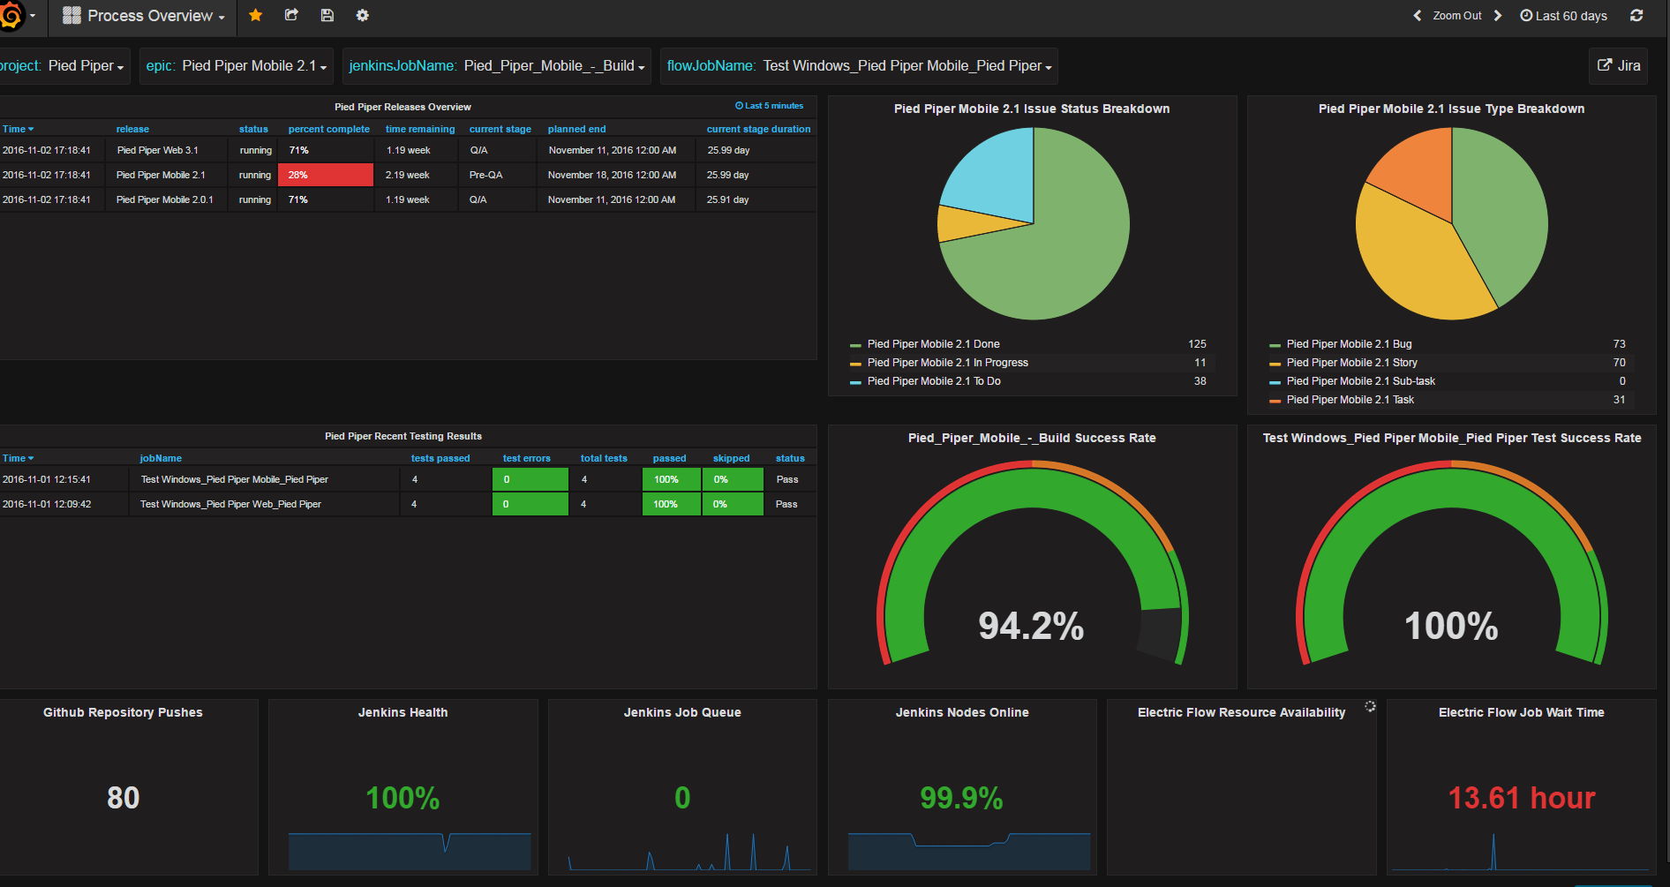

Slide 18
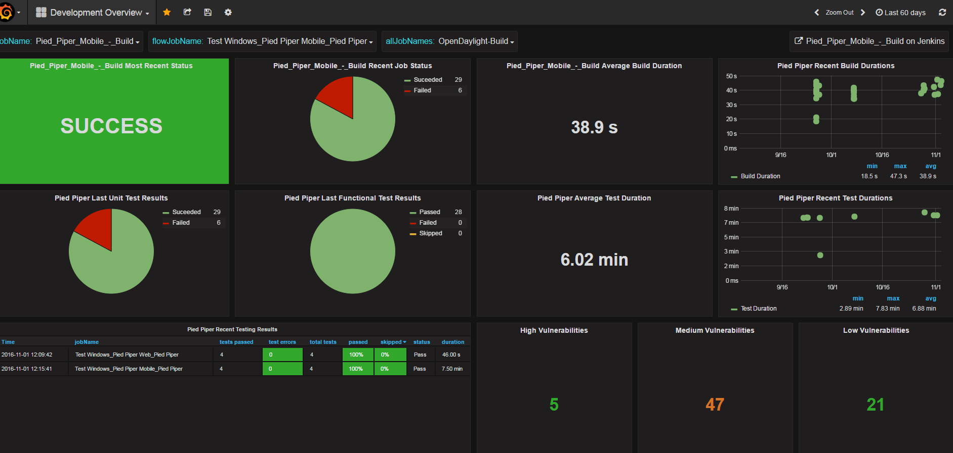

Slide 19
